Slide 1
Finding Hazard Information
Lecture 05
Syeda Farwa Rizvi

Slide 2
Contents
Material safety data sheets
Safety data sheets and the GHS (Globally Harmonized Systems)

Slide 3
Material Safety Data Sheet
A material safety data sheet is a technical document which provides detailed and comprehensive information on a controlled product related to:
health effects of exposure to the product
hazard evaluation related to the product’s handling, storage or use
measure to protect workers at risk of exposure
emergency procedures.

Slide 4
MSDS to SDS
MSDS (Material Safety Data Sheet) is now called an SDS (Safety Data Sheet).
Purpose of both MSDS and SDS documents remains unchanged and is to list the information pertaining to the occupational health and safety for the various uses of the substances and products.
MSDS and SDS are where you go if you need more information on the product and what to do if there is exposure to product or a spill.

Slide 5
MSDS vs SDS
Signal Words
SDSs, unlike MSDSs now have signal words:
Warning which means a less serious hazard
Danger which means a more serious hazard.
Hazard Classifications
Hazard Classifications for the product on an SDS include:
Health Hazard Classes
Physical Hazard Classes
Environmental Hazard Classes
These are broken down further into categories.

Slide 6
Sections of MSDS vs Sections of SDS
MSDSs had 9 sections and they varied greatly in structure and information. SDSs now have a standard 16-section format with signal words (Warning or Danger), universally standardized hazard and precautionary statements, and hazard pictograms.

Slide 7
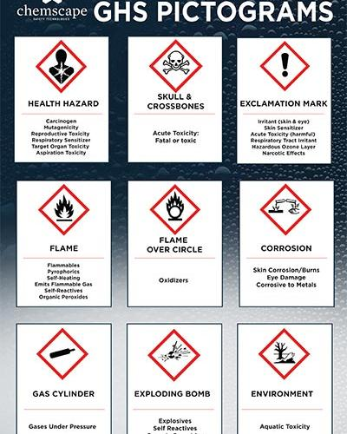

Slide 8
Sections of Safety Data Sheets
The 16 sections of an SDS include:
SDS Section 1: Product Identification
SDS Section 2: Hazard Identification
SDS Section 3: Composition/Information on Ingredients
SDS Section 4: First Aid Measures
SDS Section 4: Fire Fighting Measures
SDS Section 6: Accidental Release Measures
SDS Section 7: Handling and Storage
SDS Section 8: Exposure Controls and Personal Protection
SDS Section 9: Physical and Chemical Properties
SDS Section 10: Stability and Reactivity
SDS Section 11: Toxicological Information
SDS Section 12: Ecological Information
SDS Section 13: Disposal Considerations
SDS Section 14: Transport Information
SDS Section 15: Regulatory Information
SDS Section 16: Other Information

Slide 9
Globally Harmonized System of Classification and Labelling of Chemicals
The Globally Harmonized System of Classification and Labelling of Chemicals also known as GHS is an internationally agreed-upon standard managed by the United Nations that was set up to replace the assortment of hazardous material classification and labelling schemes previously used around the world.
It is the culmination of many years of discussion between governments and industries.

Slide 10
What is the Globally Harmonized System (GHS)?
The GHS is a system for harmonizing hazard classification criteria and chemical hazard communication elements worldwide.
The GHS is not a regulation; rather it is a framework or guidance for classifying and labeling hazardous chemicals.
The purpose of classification under the GHS is to provide harmonized information to users of chemicals with the goal of enhancing protection of human health and the environment.

Slide 11
Around the world countries have regulatory systems for chemical classification and hazard communication.
The systems may look similar, but their differences can lead to multiple interpretations and inconsistencies for a classification, label and Safety Data Sheets (SDS) for the same product.
Moving to one standard in the age of global trade simplifies regulations and improves the safety for workers who interact with hazardous products.

